Slide 1




BG6
PVN
2026 PVN FME Q1 Work Report
Dep.: BG6- Manufacturing& Operation Management Center.- VietNam Manufacturing Div.- PVN1 Factory- FME Dept.- Automation Sec.
Name: Rabbit Pham 范氏垂
Date: 2026/03/16
FME
BG6 PVN

Slide 2
BG6
PVN
Q1- 2026 Work Results
Time | Work Results
2025 Q4 | 1. Developed a clear understanding of my roles, responsibilities, and core job functions. Studied AOI equipment and programs, and learned the procedures for setting up the AOI station.
 | 2. Learned how to operate AOI stations, identified common issues occurring at the stations, and performed troubleshooting to resolve problems promptly to ensure smooth production.
2026 Q1 | 3. Conducted project training, performed testing, and monitored the AOI CCX station to identify and resolve issues.
 | 4. Set up cameras at the AOI Flex5 and Flex8 Stations.
 | 5. Participated in training for the new project, and carried out operation and monitoring activities.
FME
BG6 PVN

Slide 3
BG6
PVN
Detailed description of Work results
Performed daily machine checks before operation.
Learned how to training projects on the Cambrian System.
Learned how to retrieve data from the SFIS.
Learned the procedures for setting up an AOI station.
Identified common issues at AOI stations and resolve them.
FME
BG6 PVN

Slide 4
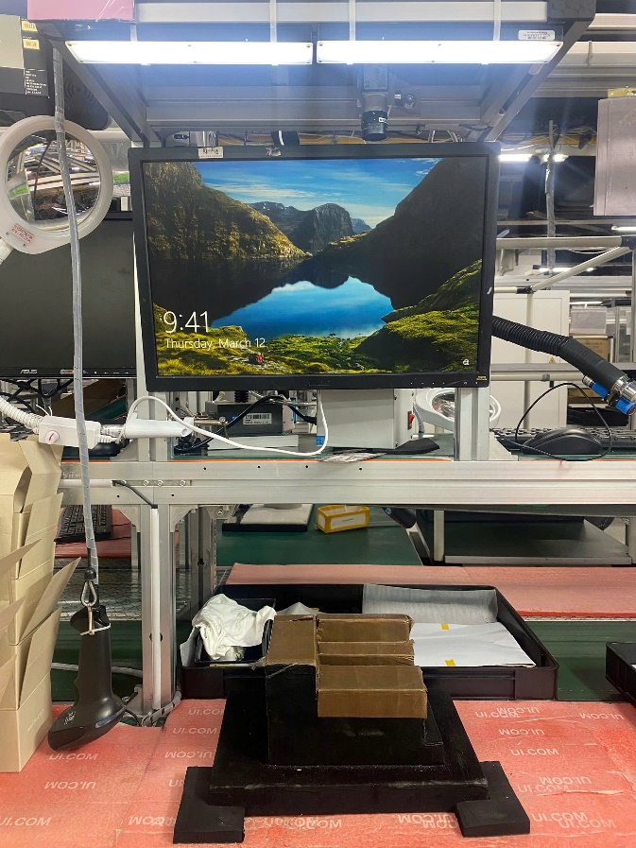
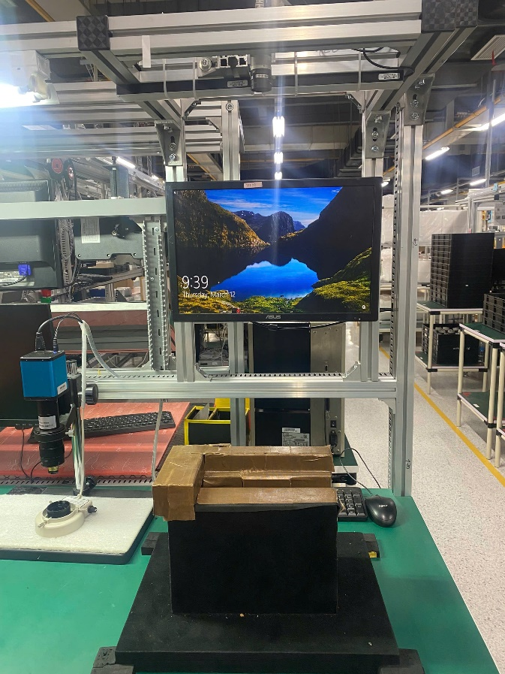
BG6
PVN
Detailed description of Work results
Set up cameras
Camera Flex5
Camera Flex8
Test area
FME
BG6 PVN

Slide 5
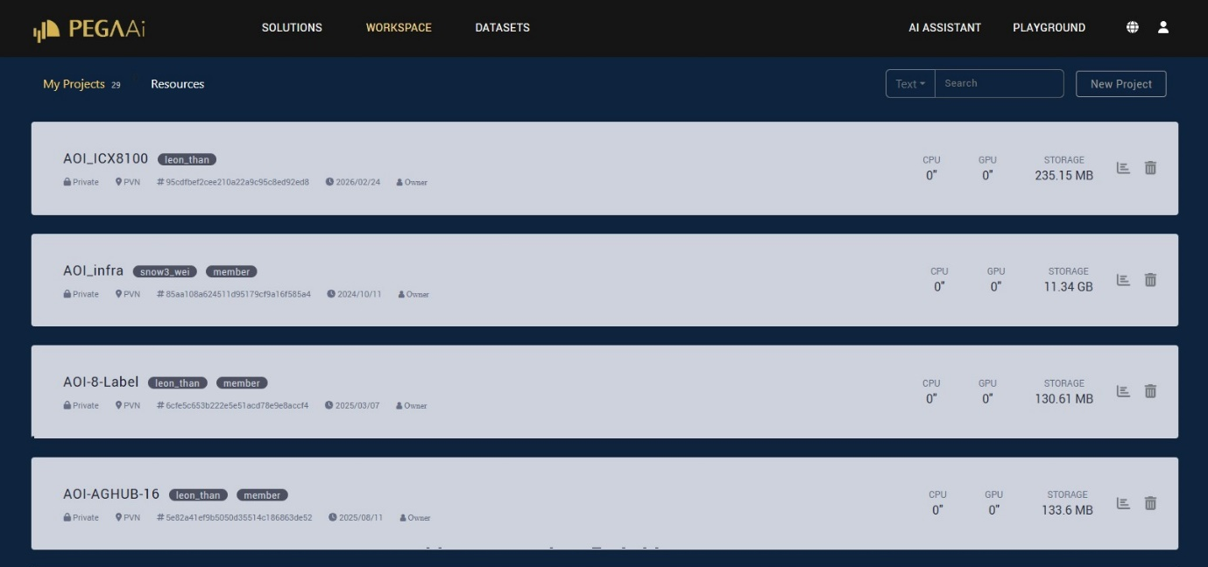
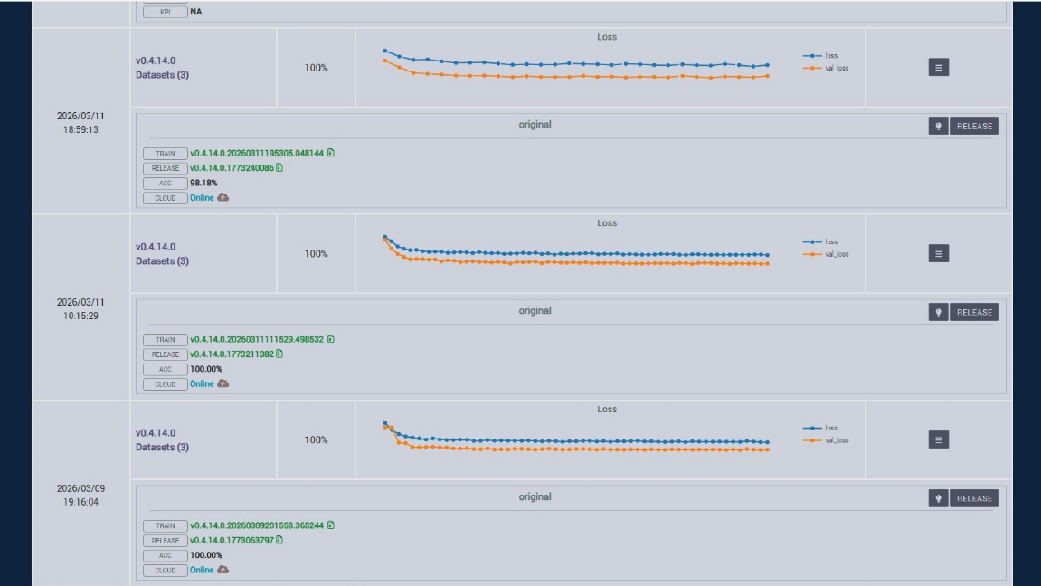
BG6
PVN
Detailed description of Work results
Training projects
Training on Cambrian System
Project created
FME
BG6 PVN

Slide 6
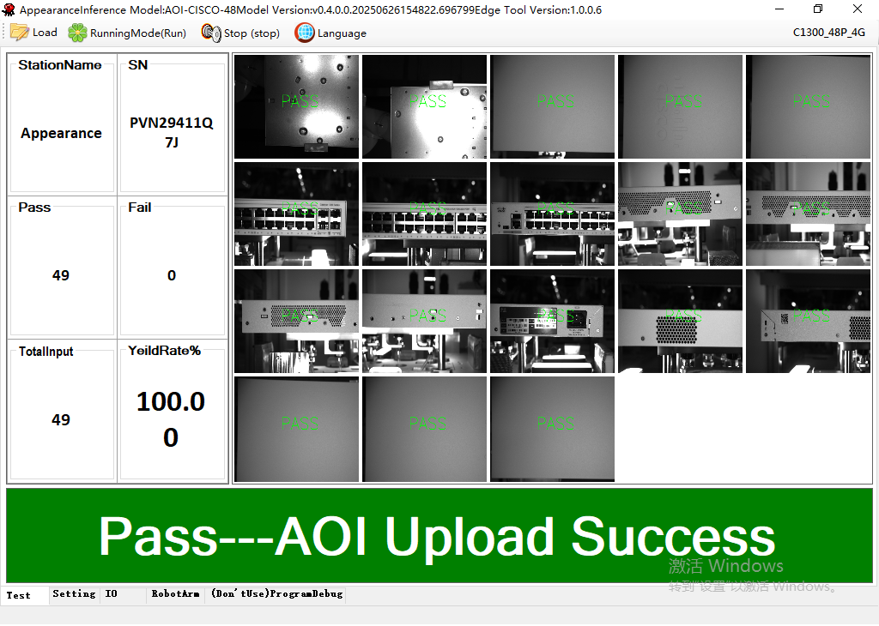
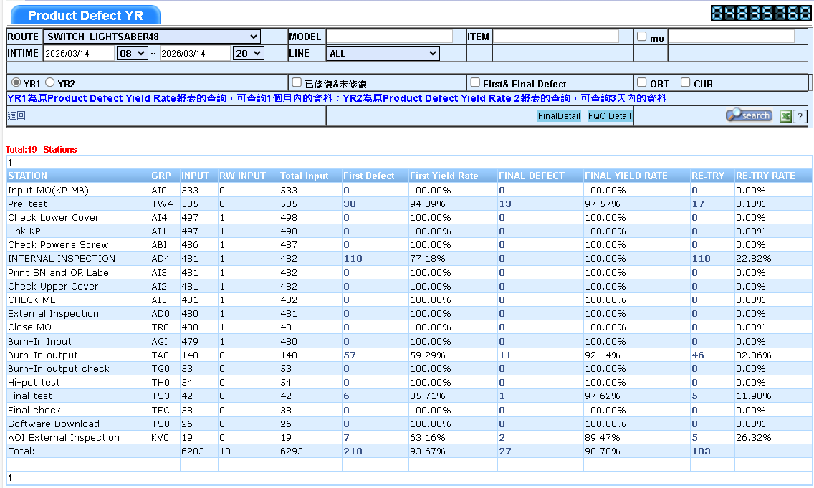
BG6
PVN
Detailed description of Work results
AOI 48P-External (4A line)
Inspection Program
SFIS Data
FME
BG6 PVN

Slide 7
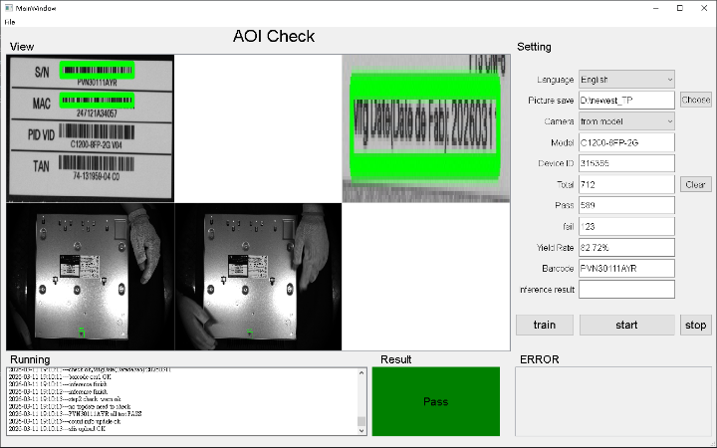
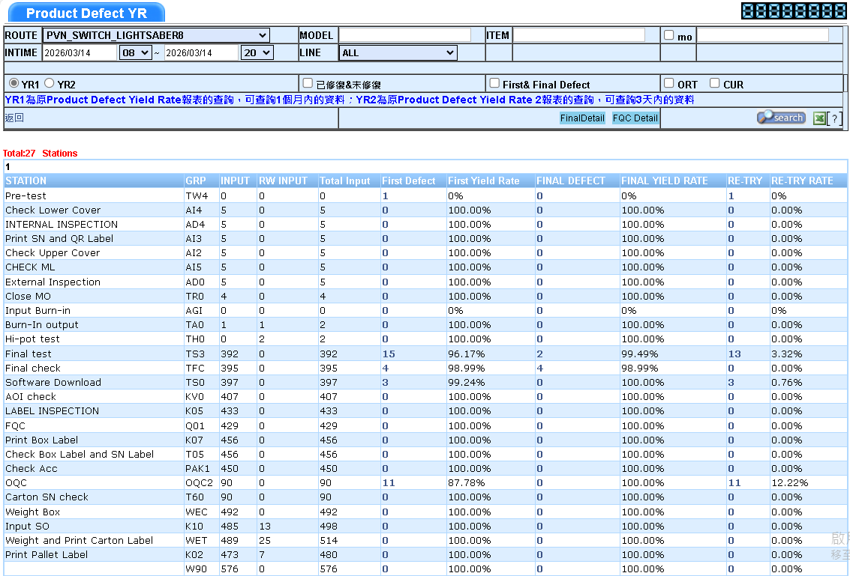
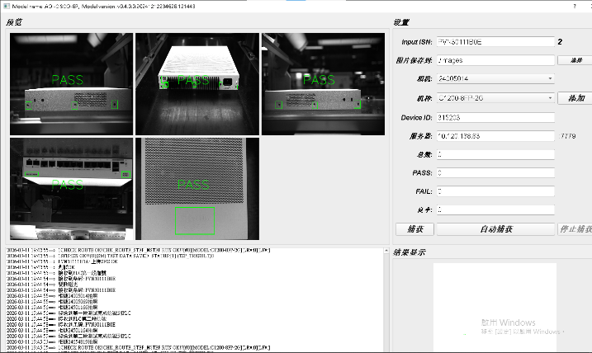
BG6
PVN
Detailed description of Work results
4B line
AOI 8P-Label
AOI 8P-External
Inspection Program
SFIS Data
FME
BG6 PVN

Slide 8
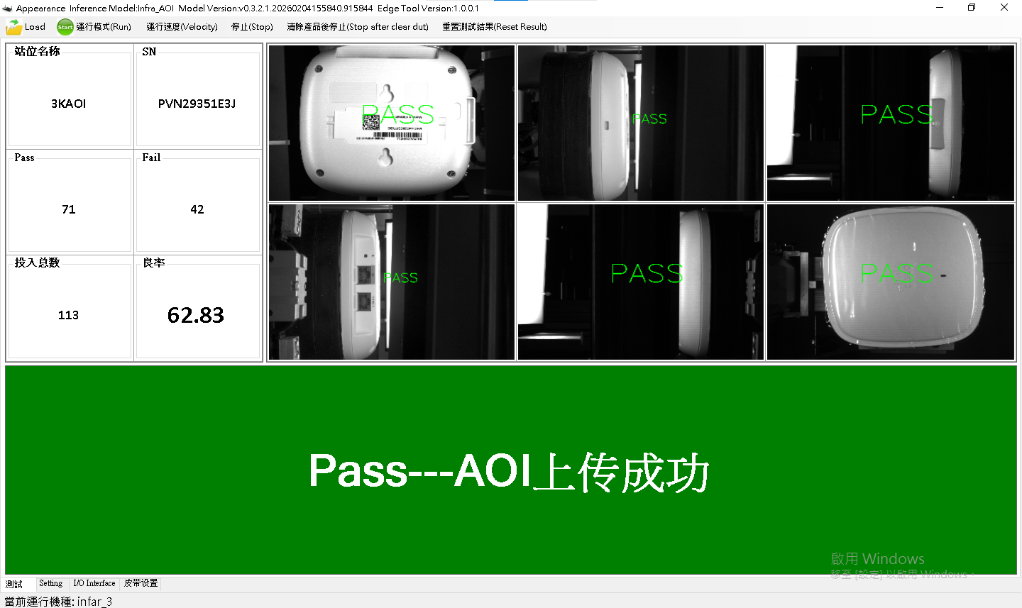
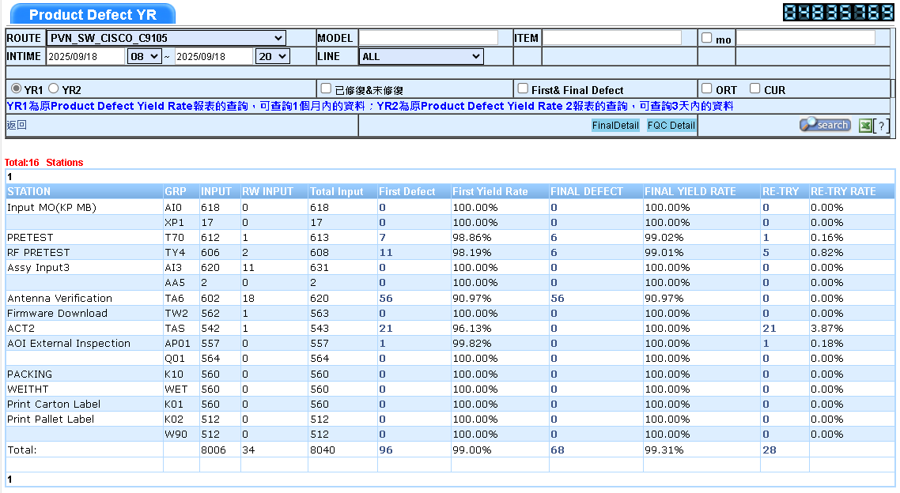
BG6
PVN
Detailed description of Work results
AOI Somerset-Infra (4C line)
Inspection Program
SFIS Data
FME
BG6 PVN

Slide 9
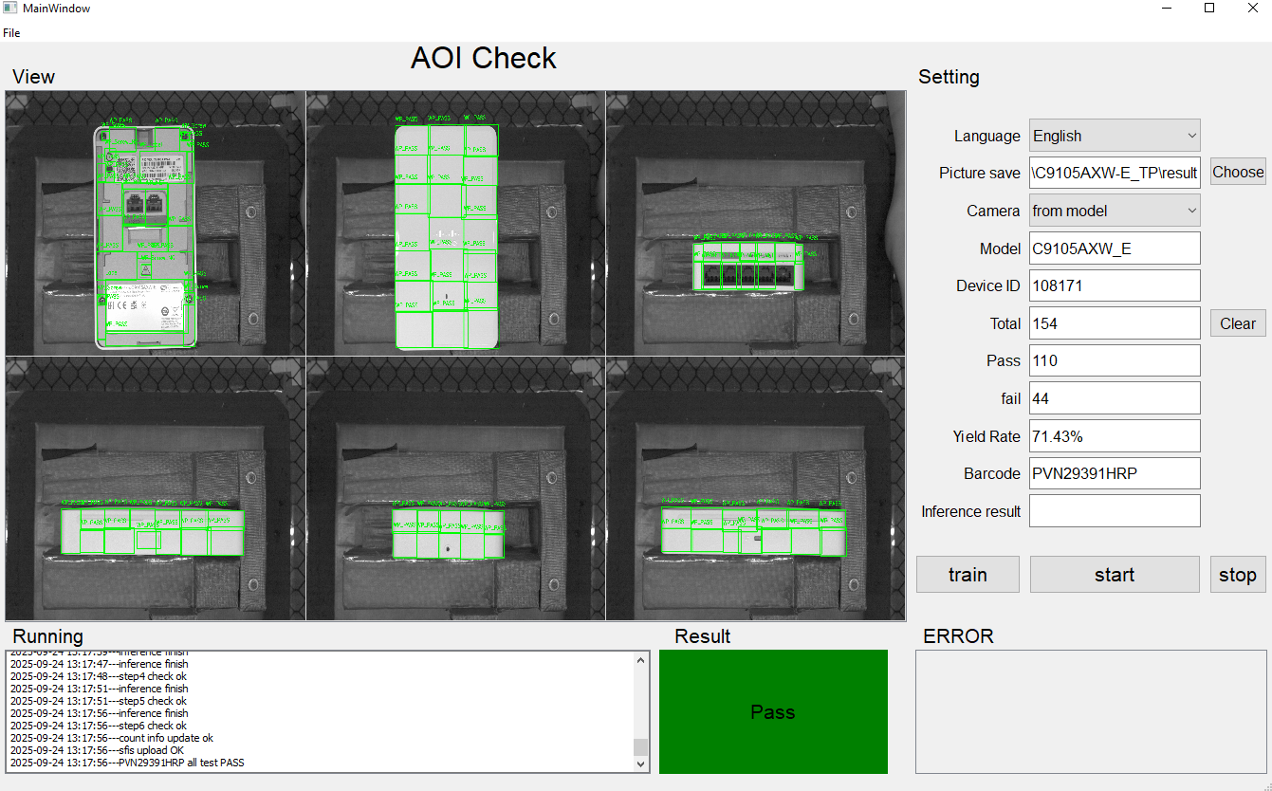
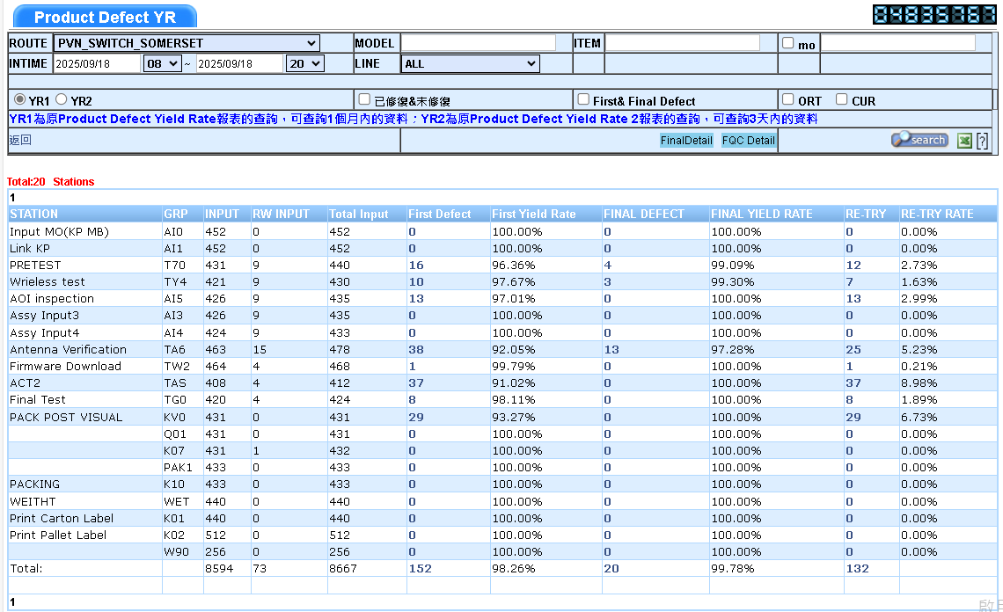
BG6
PVN
Detailed description of Work results
AOI Somerset-WP (4C line)
Inspection Program
SFIS Data
FME
BG6 PVN

Slide 10
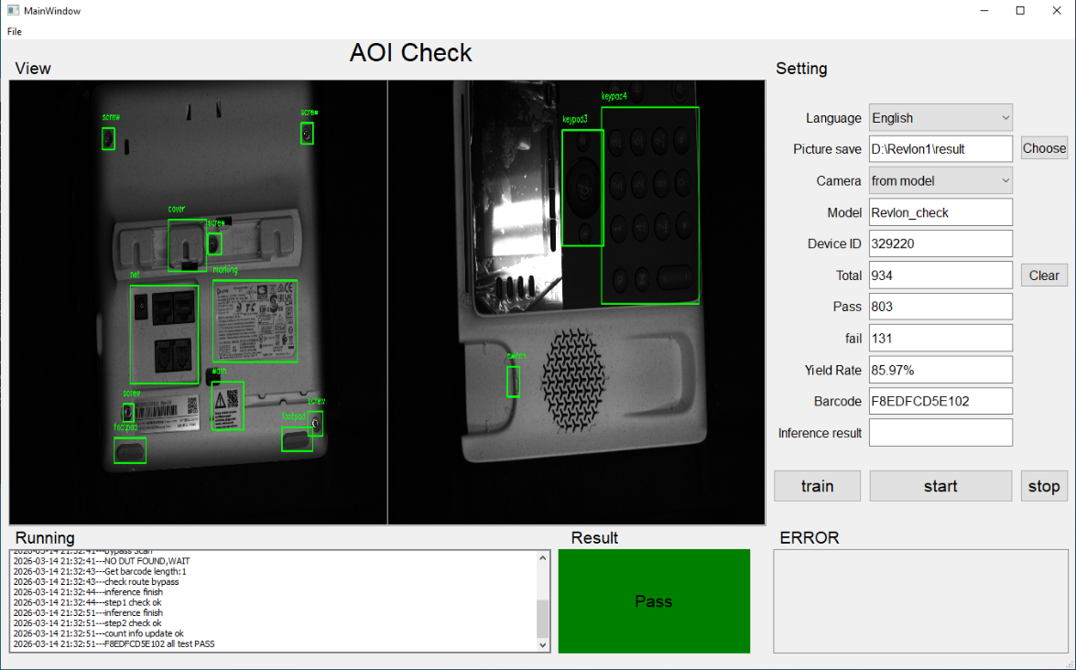
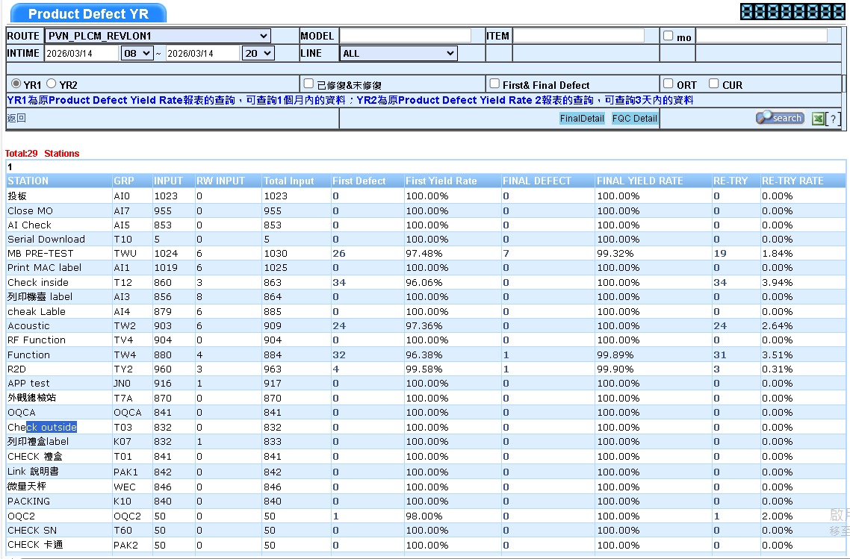
BG6
PVN
Detailed description of Work results
AOI Revlon 1 (4D line)
Inspection Program
SFIS Data
FME
BG6 PVN

Slide 11
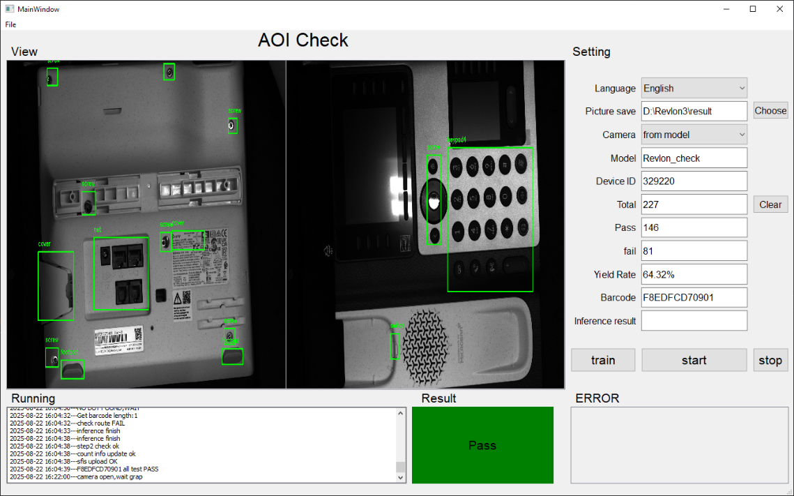
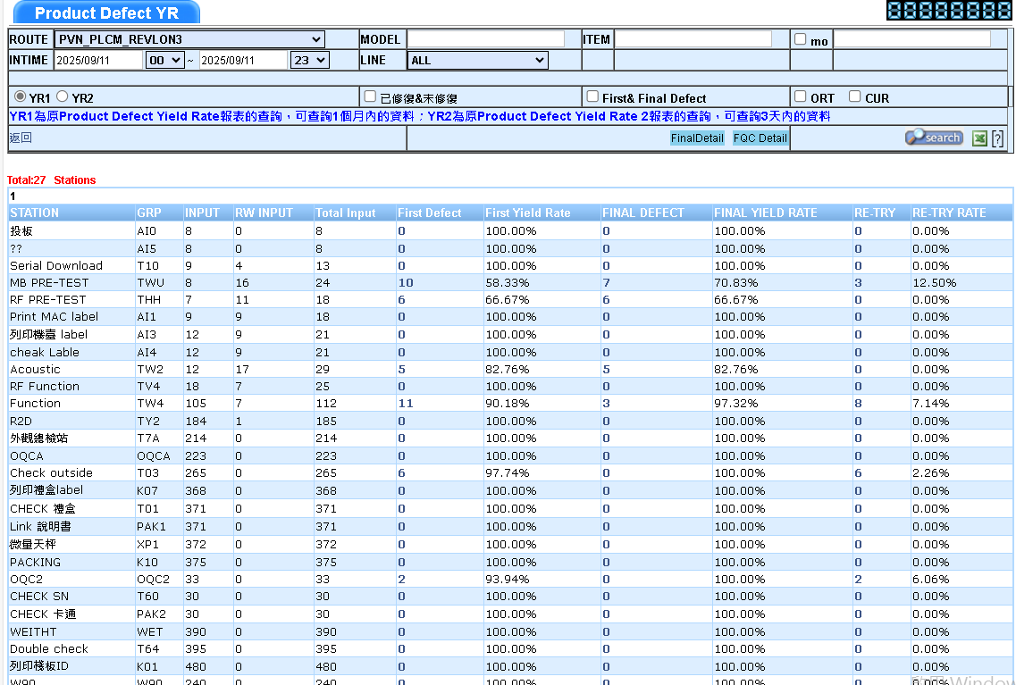
BG6
PVN
Detailed description of Work results
AOI Revlon 3 (4D line)
Inspection Program
SFIS Data
FME
BG6 PVN

Slide 12
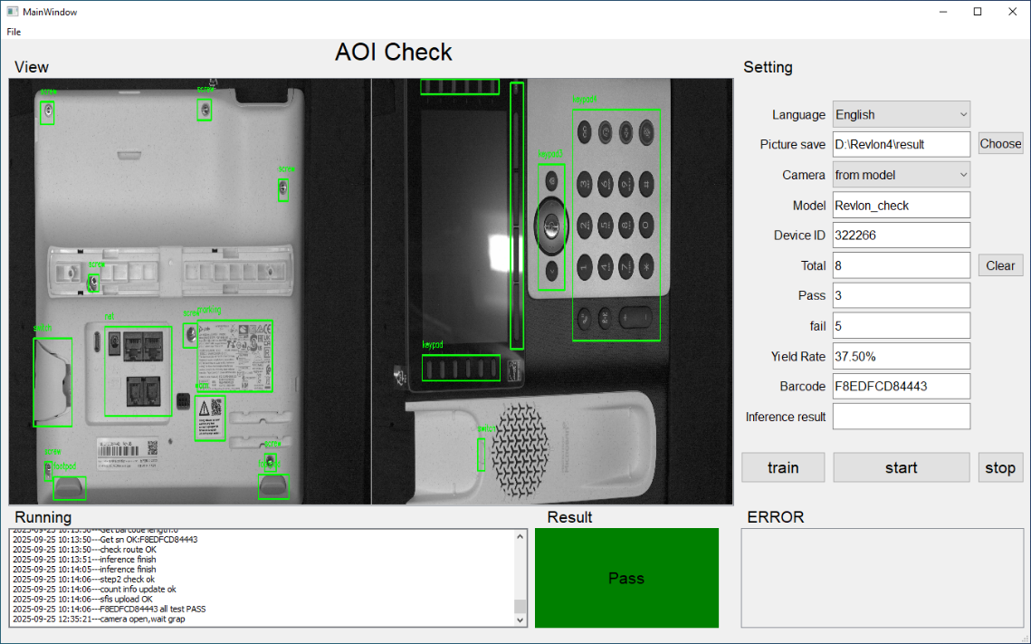
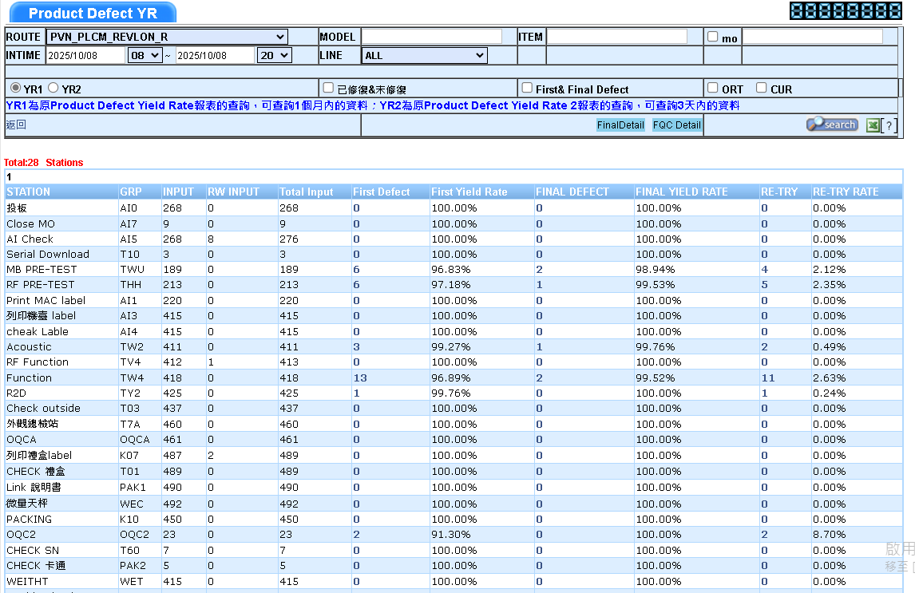
BG6
PVN
Detailed description of Work results
AOI Revlon 4 (4E line)
Inspection Program
SFIS Data
FME
BG6 PVN

Slide 13
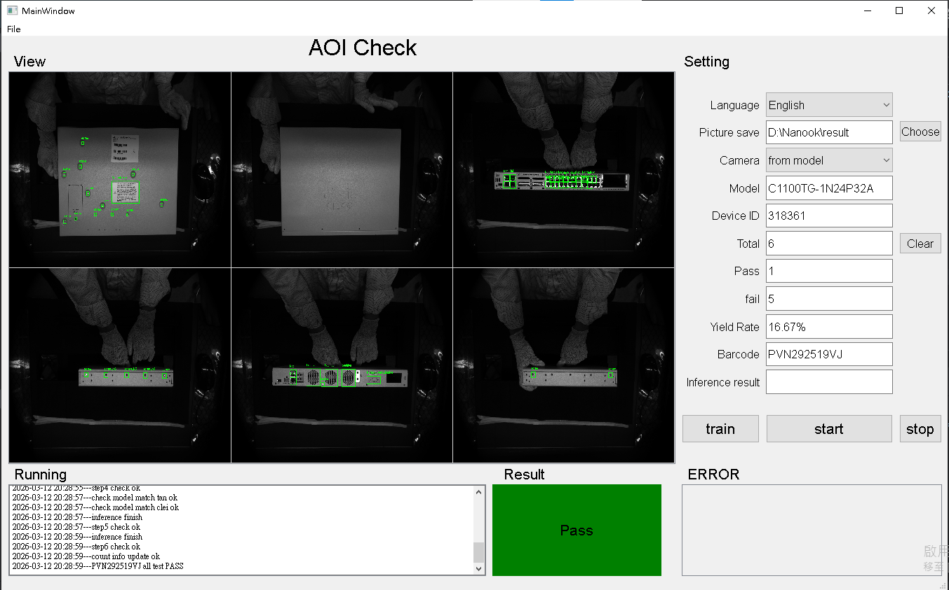
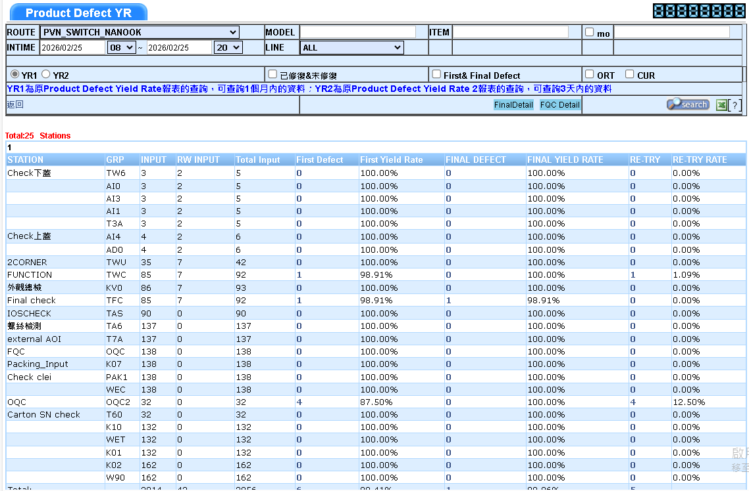
BG6
PVN
Detailed description of Work results
AOI Nanook External (4J line)
Inspection Program
SFIS Data
FME
BG6 PVN

Slide 14
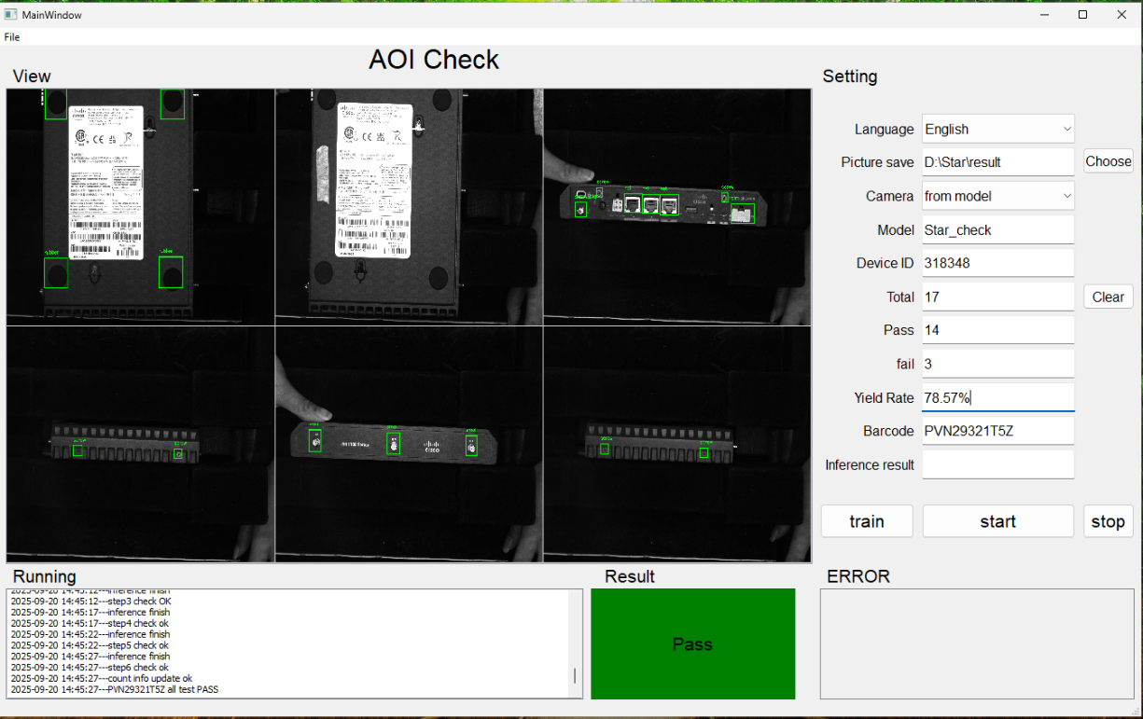
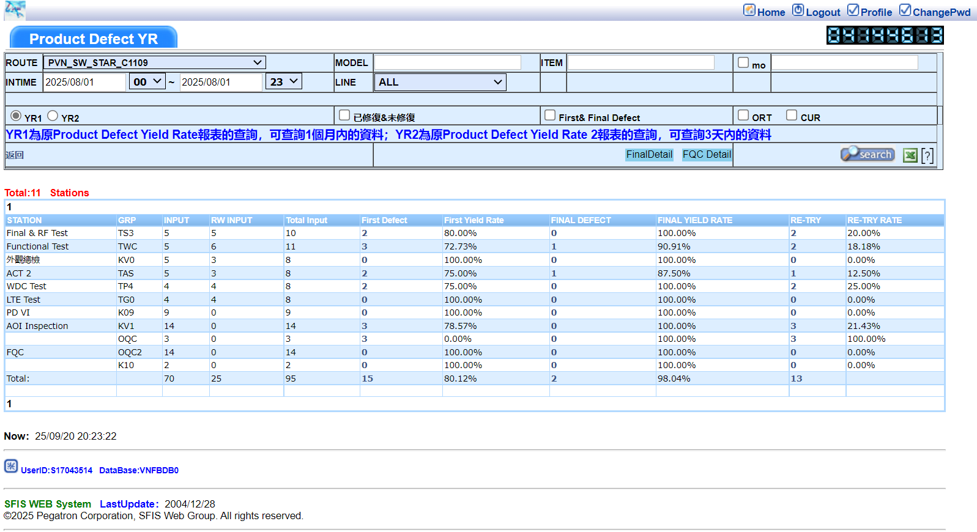
BG6
PVN
Detailed description of Work results
AOI Star (4J line)
Inspection Program
SFIS Data
FME
BG6 PVN

Slide 15
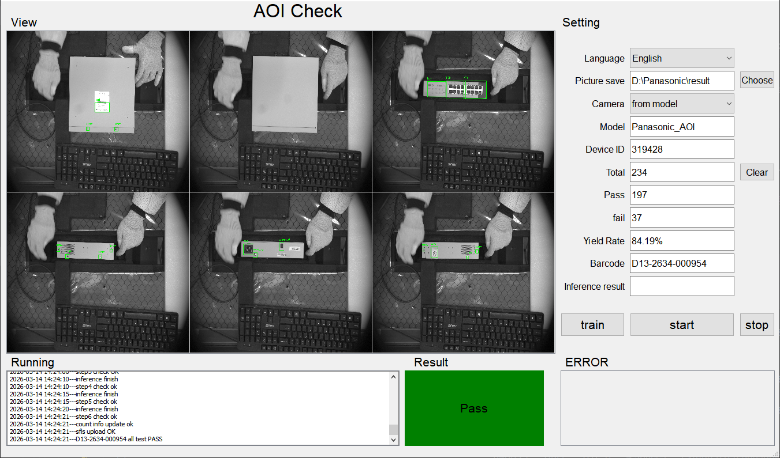
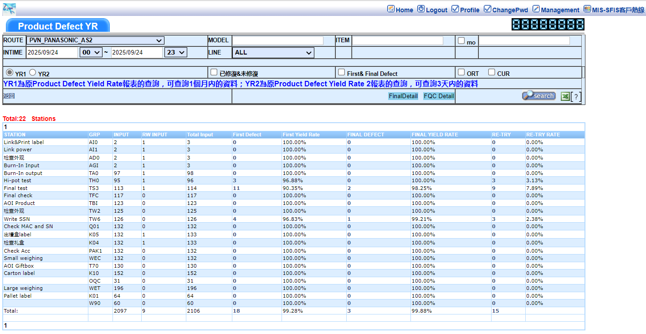
BG6
PVN
Detailed description of Work results
AOI Panasonic External (4K line)
Inspection Program
SFIS Data
FME
BG6 PVN

Slide 16
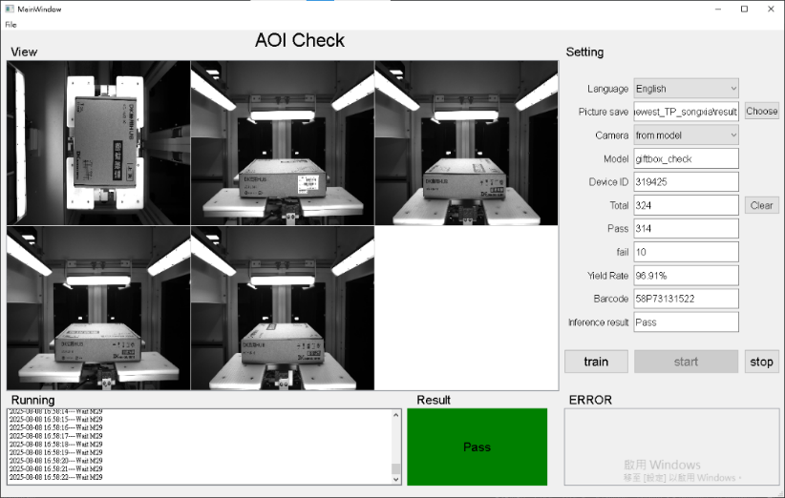
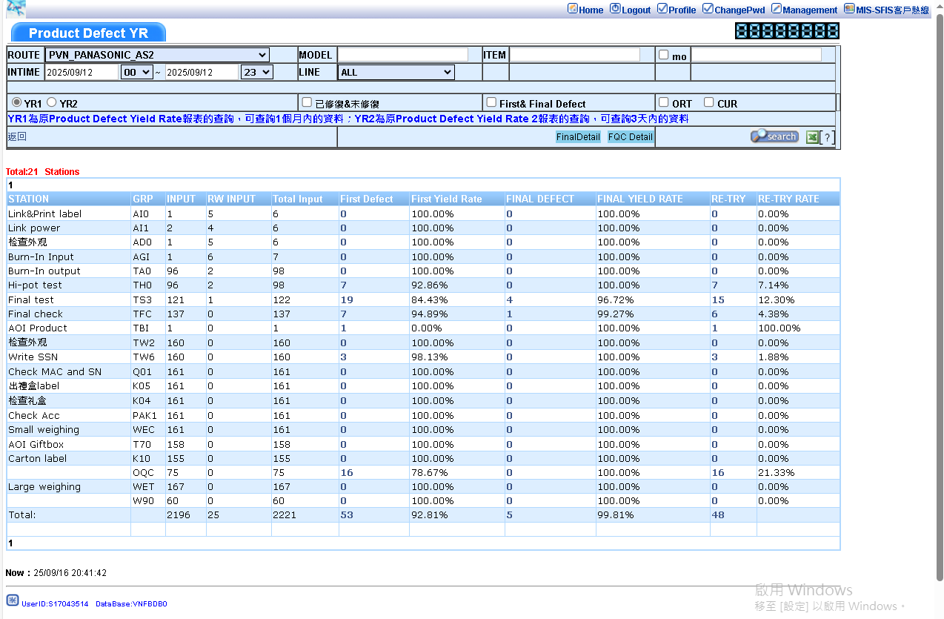
BG6
PVN
Detailed description of Work results
AOI Panasonic Giftbox (4K line)
Inspection Program
SFIS Data
FME
BG6 PVN

Slide 17
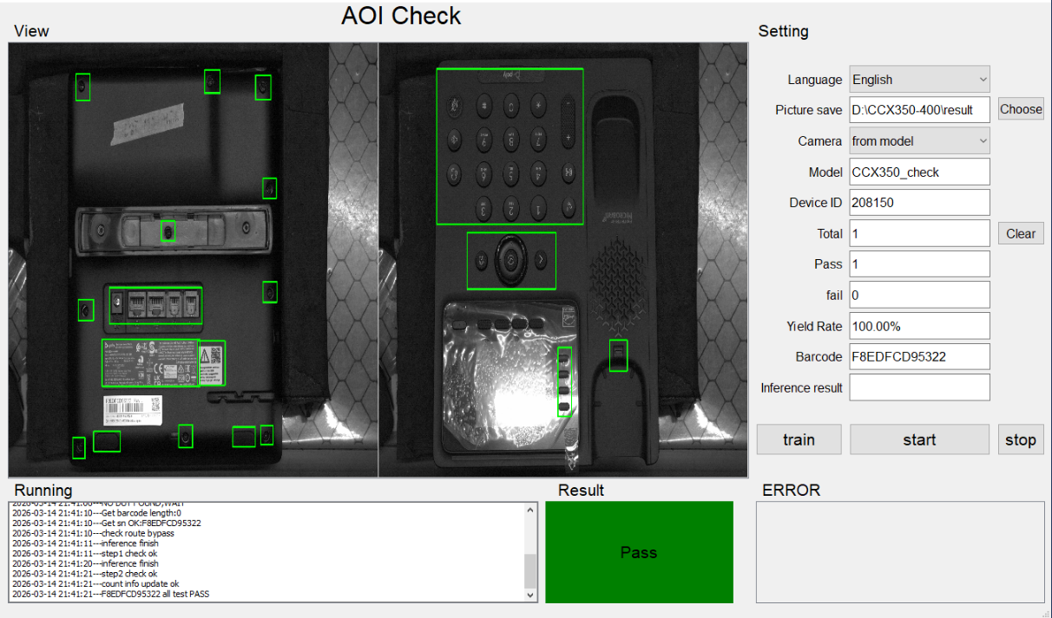
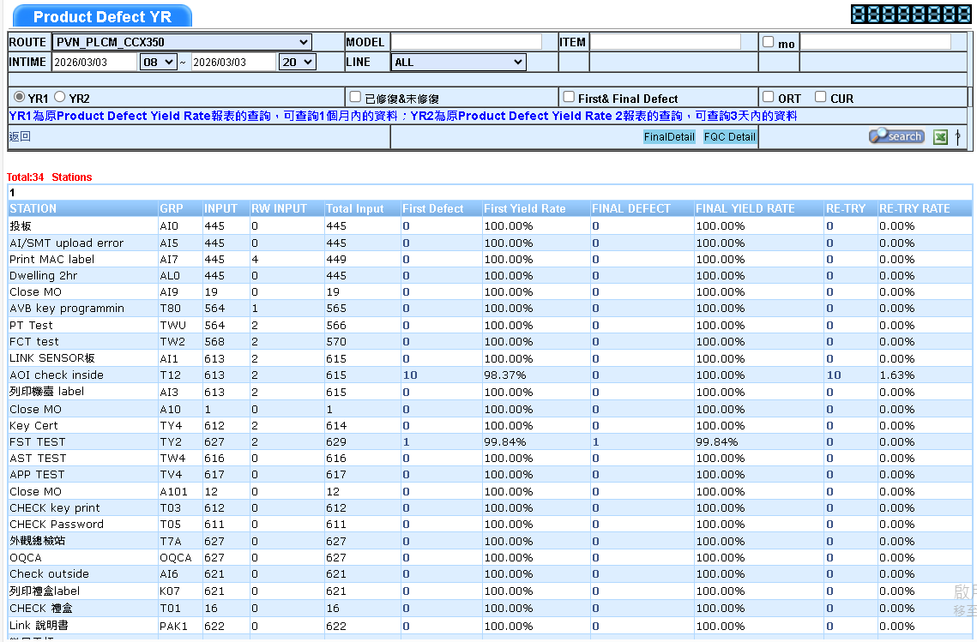
BG6
PVN
Detailed description of Work results
AOI CCX350 (4P line)
Inspection Program
SFIS Data
FME
BG6 PVN

Slide 18
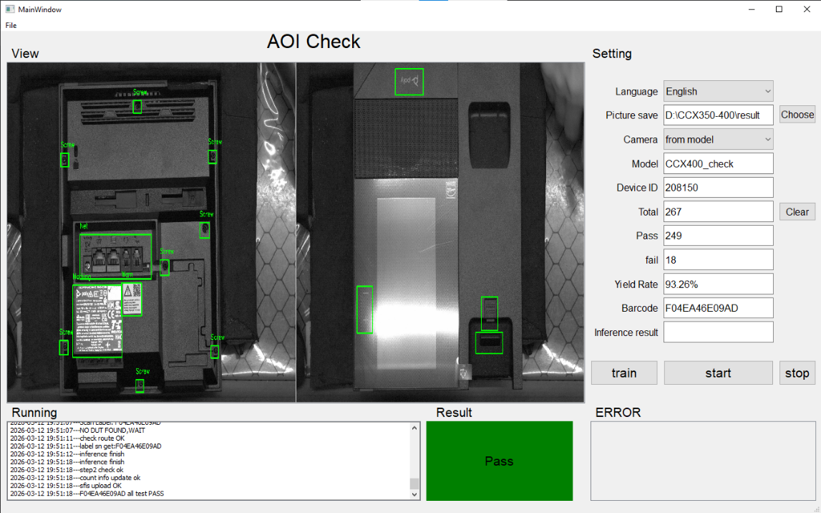
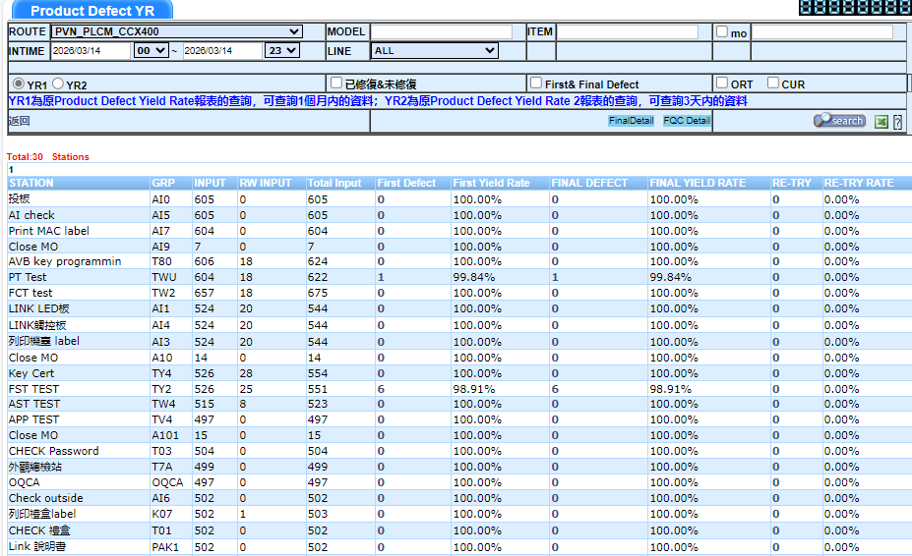
BG6
PVN
Detailed description of Work results
AOI CCX400 (4P line)
Inspection Program
SFIS Data
FME
BG6 PVN

Slide 19
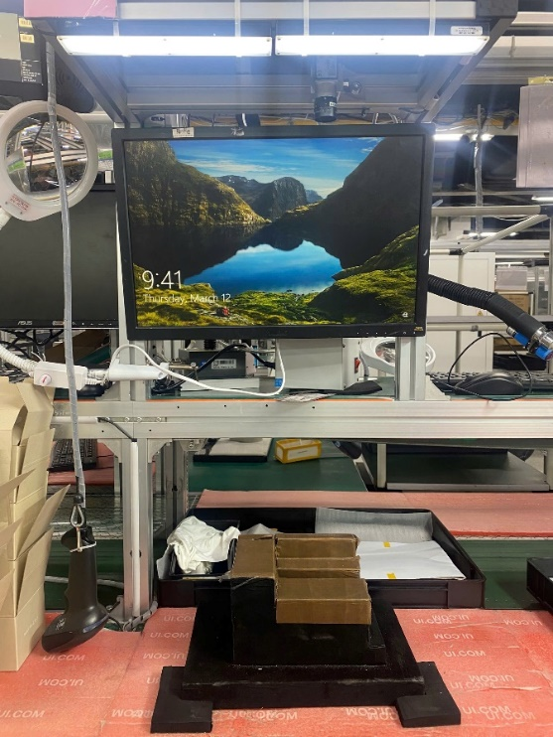
BG6
PVN
Improvement project
Process Improvements for AOI External Stations
Standardized the setup and pre-operation inspection process for the AOI external station be developing a checklist.
The checklist includes verifying lighting conditions, camera focus, system performance, and ensuring the correct inspection program is used for the product model.
A golden board verification process was implemented to validate inspection results and adjust parameters when necessary to ensure stable and accurate operation.
The improvement reduces setup-related errors, improves production stability, and helps new members follow the standard procedure more easily.
Figure: AOI external
FME
BG6 PVN

Slide 20
BG6
PVN
Q2 Work and Self- Development Plan
Time | Work and Self- Development Plan
2026 Q2~ | 1. Develop proficiency in operating the existing AOI stations.
 | 2. Develop teamwork skills to contribute ideas for production improvement.
 | 3. Develop troubleshooting skills.
FME
BG6 PVN

Slide 21
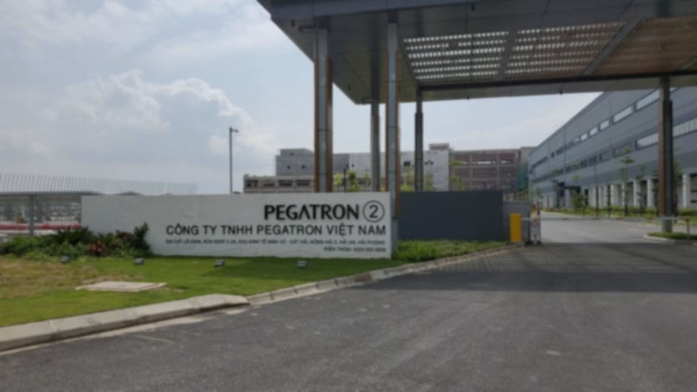
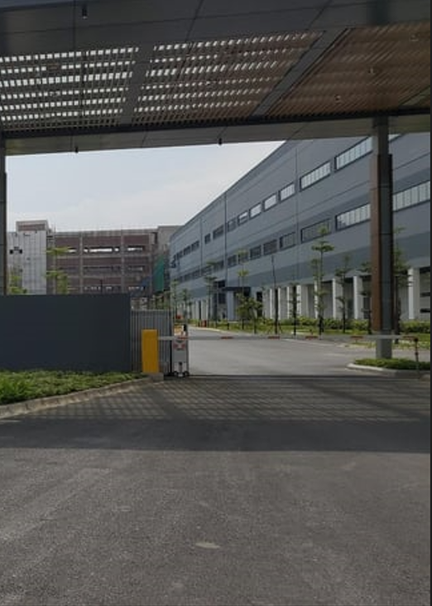

Thank You

